Slide 1
CHAPTER 6 Predictive Control with tracking 5 alternative MPC paradigms and feedforward
Anthony Rossiter

Slide 2
Background
So far this chapter has demonstrated that the default GPC (same concept for most MPC) choice of feed forward may be quite poor.
However, changing the amount of advance knowledge available is a pragmatic and simple way of determining an effective feed forward for MPC.
This video begins a brief discussion of whether modifications to the basic GPC set up are possible or useful.

Slide 3
Poorly posed optimisations
The reason the feedforward is poorly defined is because the optimisation is poorly defined.
As discussed earlier, it is rather obvious that one cannot track effectively a target change at the nth sample using control moves near the mth sample where n, m are not close together.
For a well defined optimisation, the flexibility in the predicted control trajectory must be sufficient to closely match the desired closed-loop trajectory.
One might ask how this line of reasoning affects possible changes to GPC?

Slide 4
Concepts of blocking 1
A weakness of GPC (and indeed OMPC), is that all the d.o.f. are in the immediate transients of the predicted input trajectory.
This is obviously incompatible with changes in the target several samples into the future, but as observed one can effectively get around this by deliberately not looking at the targets too far ahead.
Nevertheless, there remain scenarios where one needs or desires some flexibility in the input predictions many samples into the future, while not resulting in a very large nu.
Typically such scenarios can arise where there are hard constraints which are active many samples into the future, but not in immediate transients.

Slide 5
Concepts of blocking 2
Blocking is an approach whereby the degrees of freedom within the predicted input trajectory are spread over the output horizon rather than begin focussed in transients.
For example, allow changes
at samples 0,a,b.

Slide 6
Concepts of blocking 3
While blocking is conceptually simple and appealing, there are a number of serious theoretical shortcomings.
It is difficult to be systematic in selecting which control increments will be degrees of freedom. Even more an issue for MIMO problems!
The structure of the predictions will not normally include the tail (see video 4_6) and consequently it is difficult to make arguments about the optimisation being well posed and leading to consistent decision making from one sample to the next.
There are several papers on this type of approach in the literature for interested viewers to pursue, but this line of thought is not continued in this video book.

Slide 7
Orthonormal functions
There has been a fair bit of work looking at alternative ways of defining the input predictions, so that rather than being simple increments, instead one can consider the input predictions as a linear combination of other trajectories, for example:
d.o.f are the linear combination of the columns
The columns define the shapes of allowable trajectories
For a fixed number of d.o.f. in θ, the predicted input trajectories may evolve over a much longer horizon.

Slide 8
Orthornormal functions
A popular choice of the columns defining the shapes of the input prediction trajectories is based on orthonormal functions such as Laguerre and Kautz.
However, while authors have shown clear benefits of this type of modification, none of the work has tackled the use of advance knowledge within tracking and so that is discussed no further for now.

Slide 9
Summary
While other parameterisations of the input prediction trajectories are possible and allow clear benefits to an MPC design, as yet little work has appeared on how these allow more effective use of advance knowledge and improve the choice of the feed forward compensator.
The use of blocking and orthonormal functions are not considered further in this chapter.

Slide 10



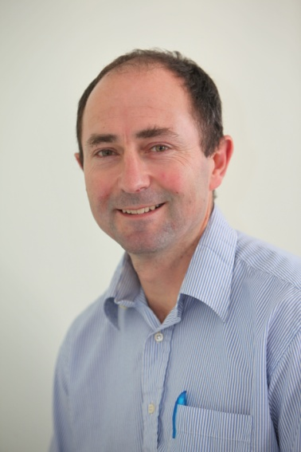
Anthony Rossiter
Department of Automatic Control and Systems Engineering
University of Sheffield
www.shef.ac.uk/acse
© 2014 University of Sheffield
This work is licensed under the Creative Commons Attribution 2.0 UK: England & Wales Licence. To view a copy of this licence, visit http://creativecommons.org/licenses/by/2.0/uk/ or send a letter to: Creative Commons, 171 Second Street, Suite 300, San Francisco, California 94105, USA.
It should be noted that some of the materials contained within this resource are subject to third party rights and any copyright notices must remain with these materials in the event of reuse or repurposing.
If there are third party images within the resource please do not remove or alter any of the copyright notices or website details shown below the image.
(Please list details of the third party rights contained within this work.
If you include your institutions logo on the cover please include reference to the fact that it is a trade mark and all copyright in that image is reserved.)

